Slide 1
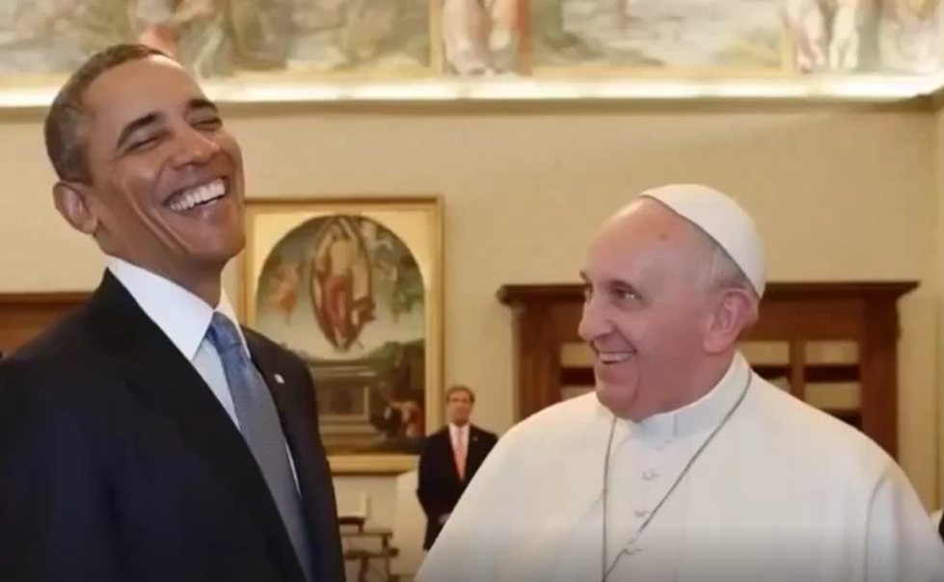
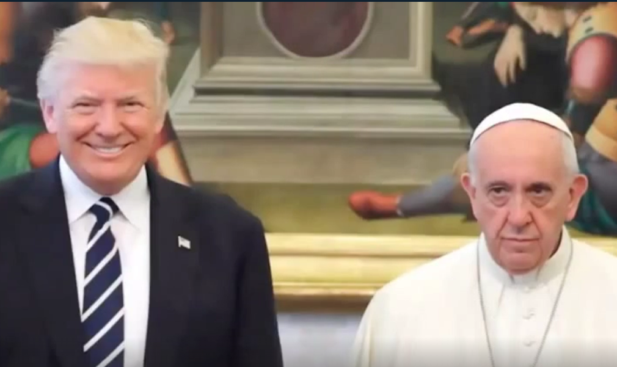
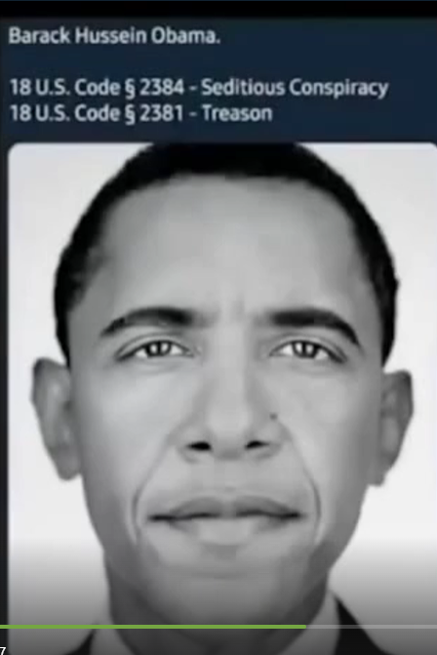
Trump to Pope Francis: “You might want to put your red shoes on when you look at all of this…”
Birds of a Feather
Trump showed Pope Francis a file of his red shoe activities… who then conceded control of world banks to Trump.
Barack Hussein Obama
18 U.S. Code § 2384 – Seditious Conspiracy
18 U.S. Code § 2381 – Treason
RED SHOES = Child Sacrifice, Signifies Cannibalism,
Made from Human Skin.
Notes:
Trump to Pope Francis: “You might want to put your red shoes on when you look at all of this…”
RED SHOES = Child Sacrifice & Made from Human Leather plus Signify Cannibalism.

Slide 2
Trump to Pope Francis: “You might want to put your red shoes on when you look at all of this…”
Birds of a Feather
We got the evil little Bastard!
I’m totally $crewed!
Barack Hussein Obama
18 U.S. Code § 2384 – Seditious Conspiracy
18 U.S. Code § 2381 – Treason
RED SHOES = Child Sacrifice & Made from Human Leather plus Signify Cannibalism.
Notes:
Trump to Pope Francis: “You might want to put your red shoes on when you look at all of this…”
RED SHOES = Child Sacrifice & Made from Human Leather plus Signify Cannibalism.

Slide 3
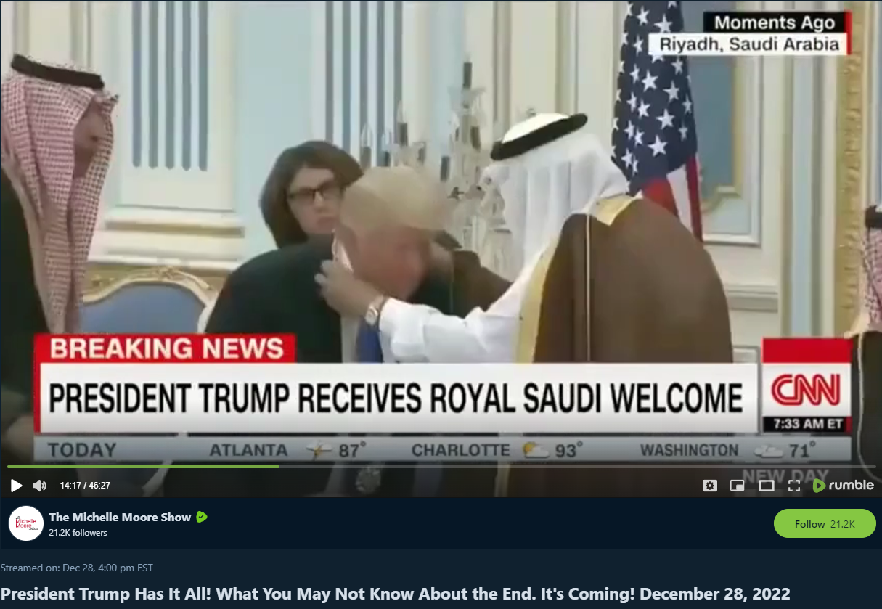
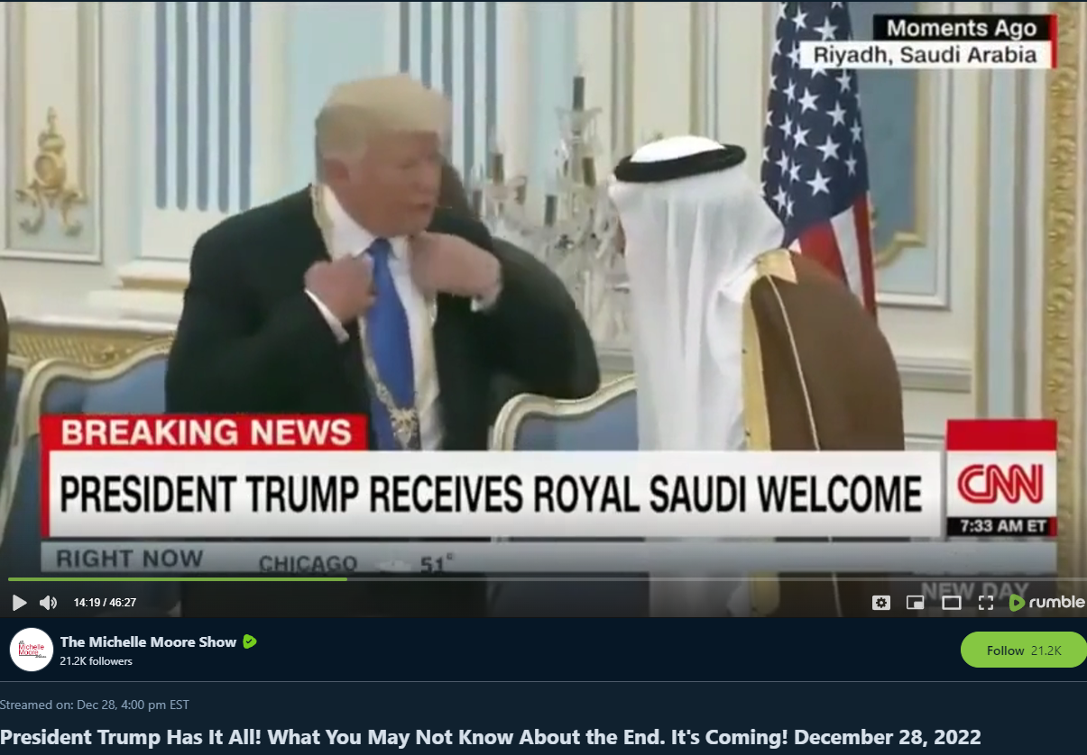
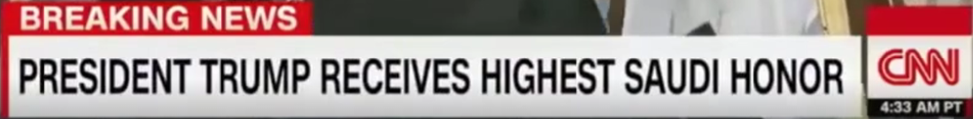
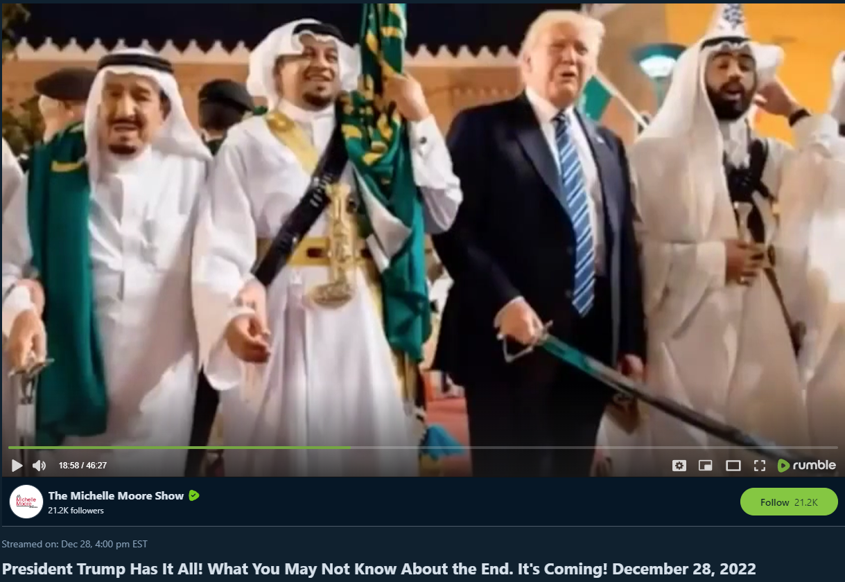
Only the KING Holds the Sword!
Only the KING Holds the Sword!

Slide 4
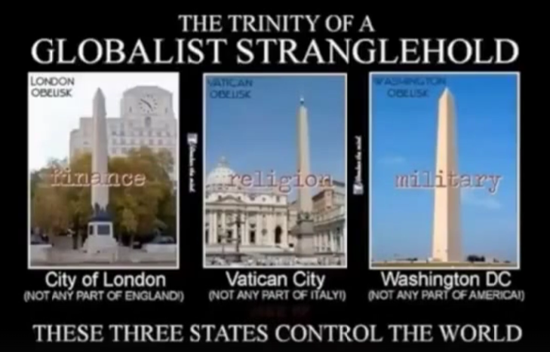
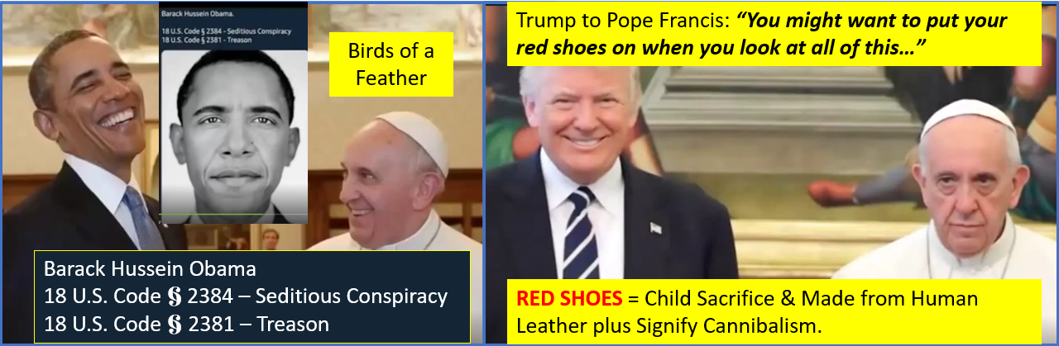
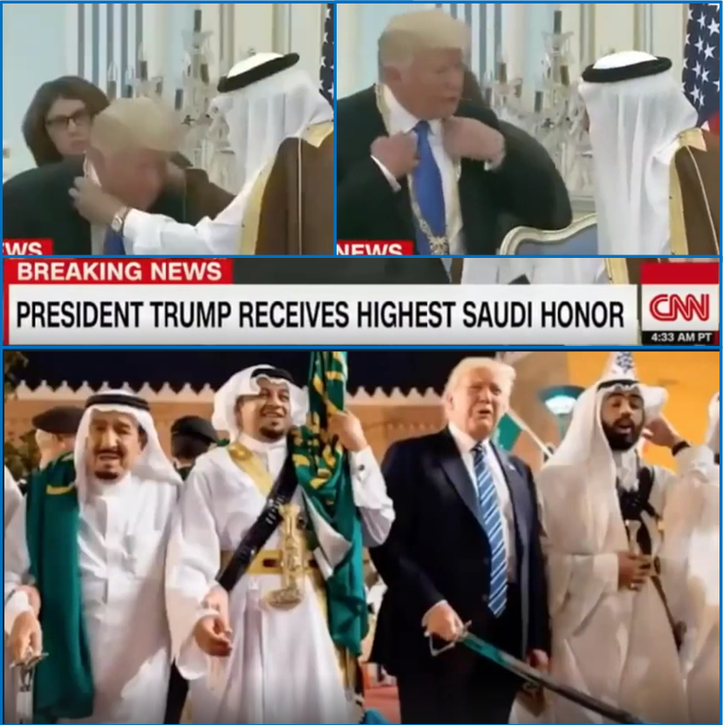
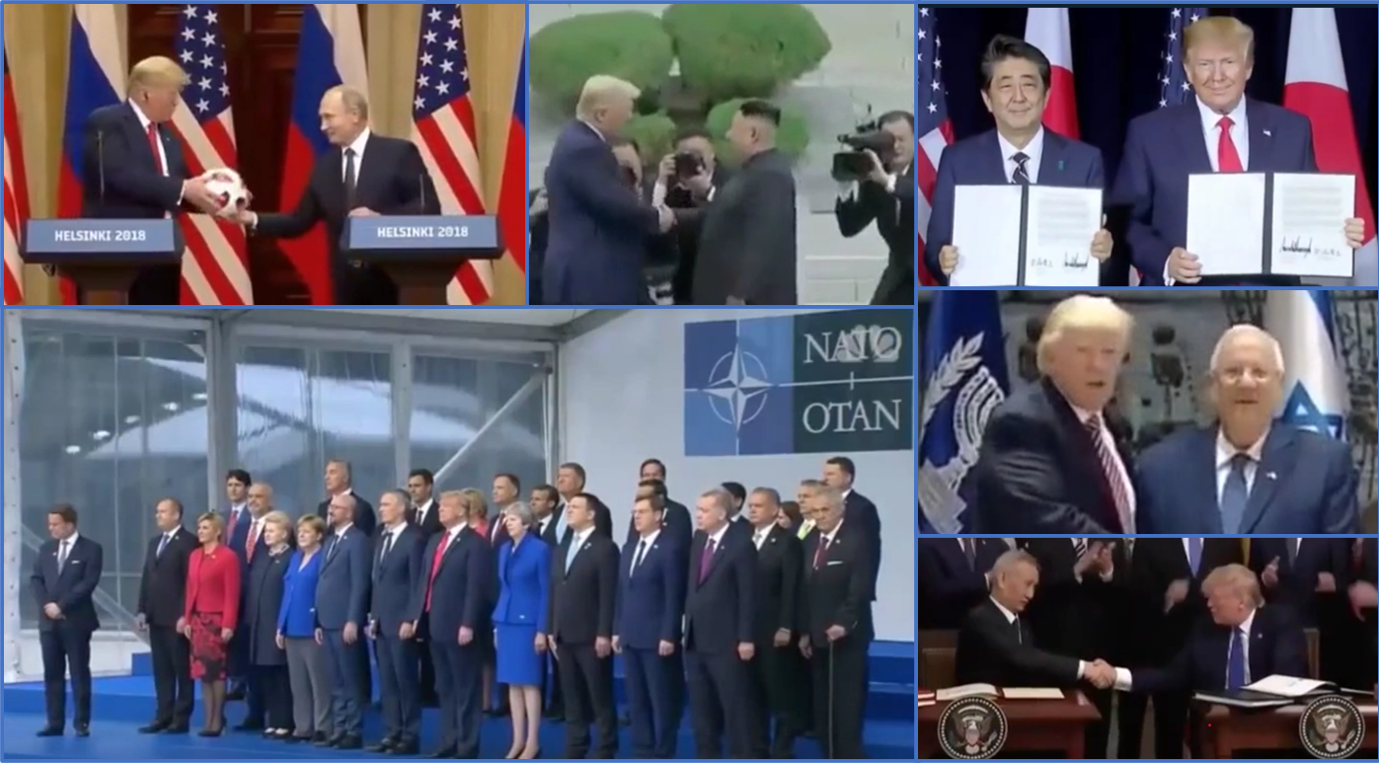
Notes:
Charlie Freak
The Q Team’s Takedown of the Cabal From A to Z
https://rumble.com/v22tbpu-special-presentation-december-28-2022.html

Slide 5
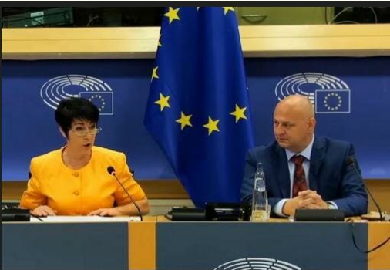
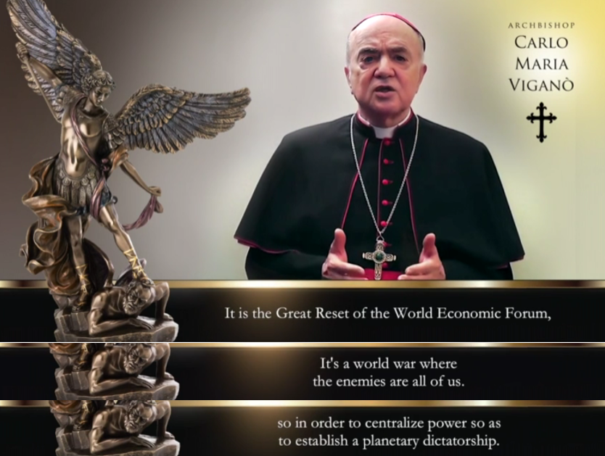
Notes:
“We Will Bring You Down”: German MP Vows To Dismantle the WHO’s Grip On Governments (2023.07.21)
https://needtoknow.news/2023/07/we-will-bring-you-down-german-mp-vows-to-dismantle-the-whos-grip-on-governments/
ARCHBISHOP CARLO MARIA VIGANO
https://stopworldcontrol.com/vigano/

Slide 6
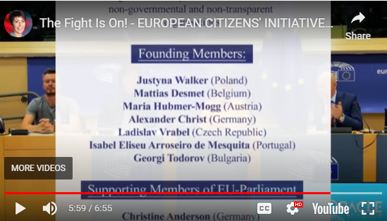
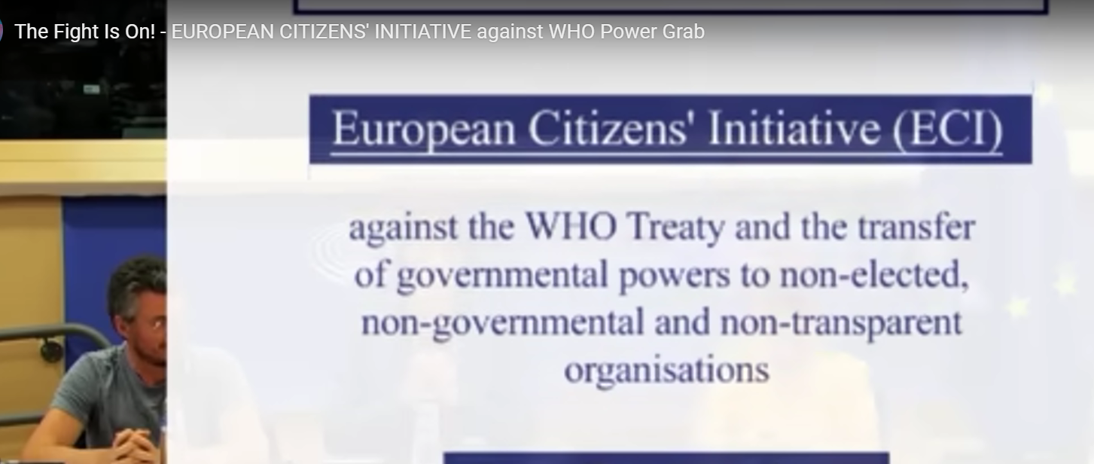
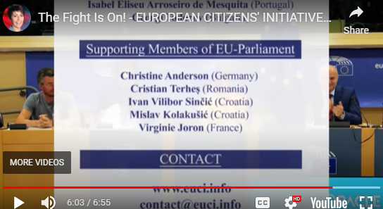
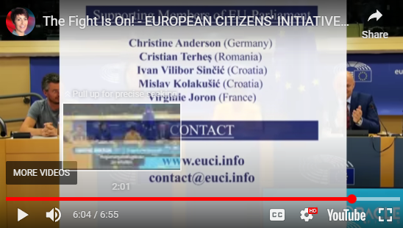
Notes:
European Citizens’ Initiative (ECI)
Against the WHO Treaty and the transfer of governmental powers to non-elected, non-governmental and non-transparent organizations.
Founding Members:
Justyna Walker (Poland), Mattias Desmet (Belgium), Dr Maria Hubmer-Mogg (Austria), Alexander Christ (Germany), Ladislav Vrabel (Czech Republic), Isabel Eliseu Arroseiro de Mesquita (Portugal), Georgi Todorov (Bulgaria)
Supporting Members of EU-Parliament:
Christine Anderson (Germany), Cristian Terhes (Romania), Ivan Vilibor Sincic (Croatia), Mislav Kolakusic (Croatia), Virginie Joron (France)
Other speakers:
Philippe Kruse, Vicky Ketion, Dr Peter MuCullough, Andrew Bridgen, Fiona Hine, Dr David E. Martin, Gerald Hauser, Nathaniel Pawlowski, Pastor Artur Pawlowski, Nick Hudson,
Contact:
www.euci.info
Contact@euci.info

Slide 9
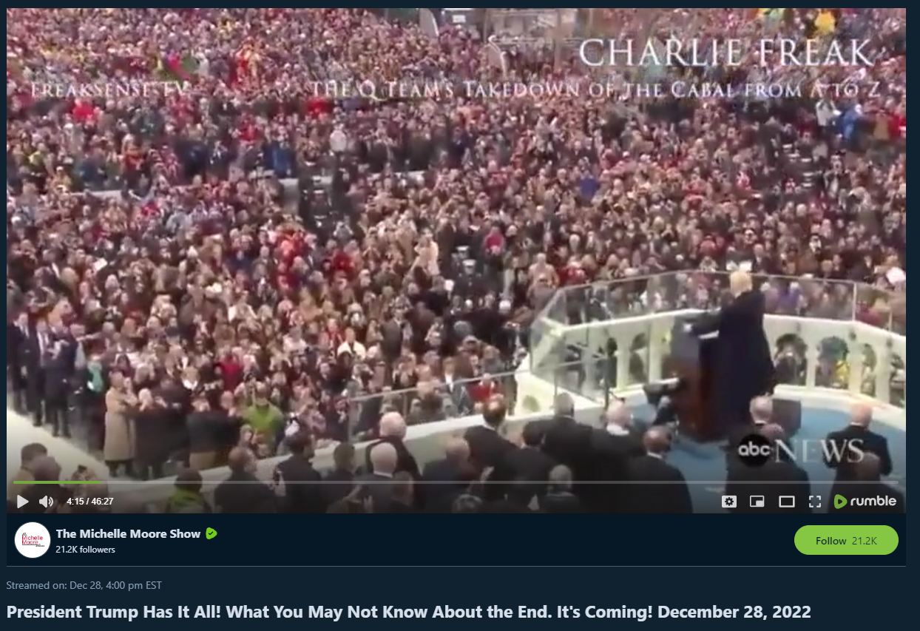
Notes:
Charlie Freak
The Q Team’s Takedown of the Cabal From A to Z
https://rumble.com/v22tbpu-special-presentation-december-28-2022.html

Slide 10
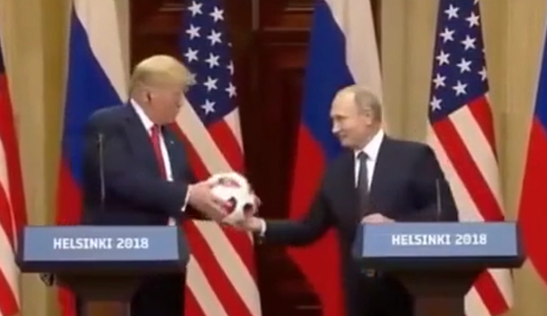
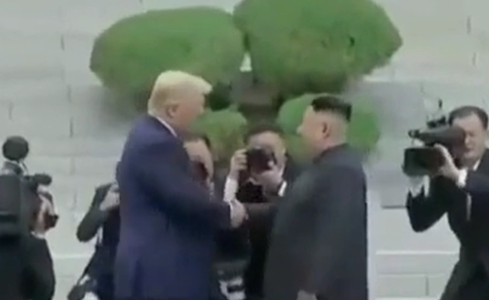

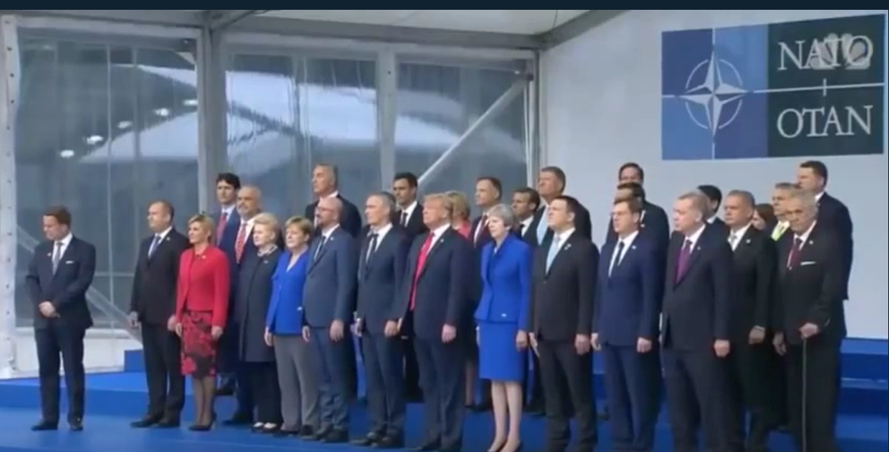
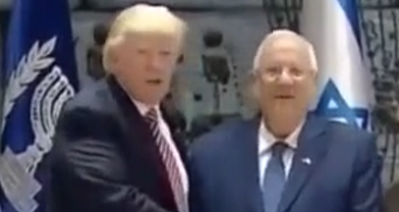
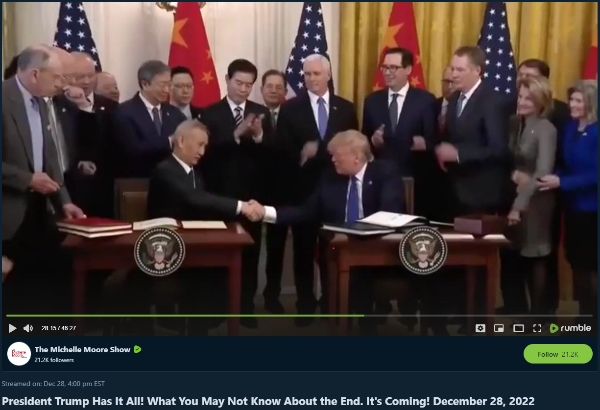

Slide 11
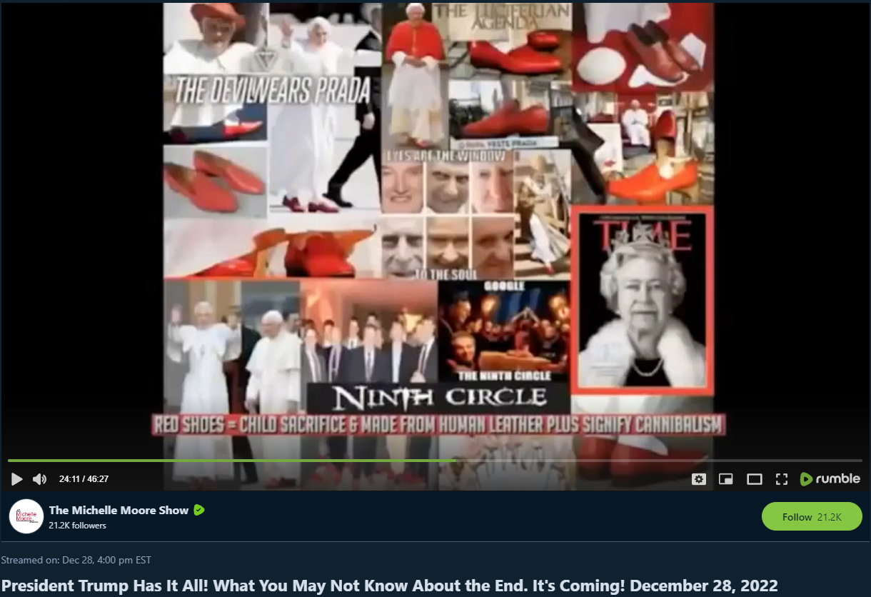

Slide 14
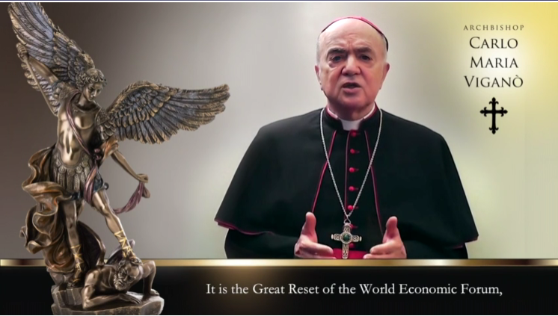

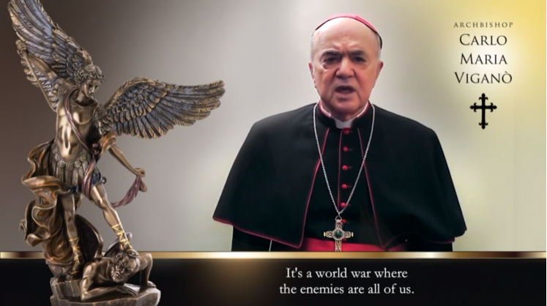
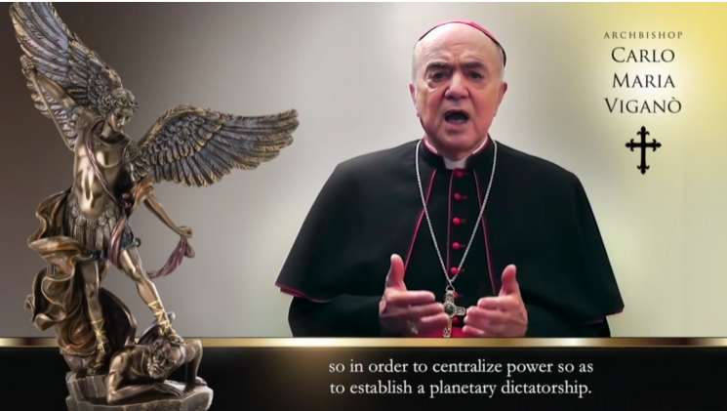

Slide 16
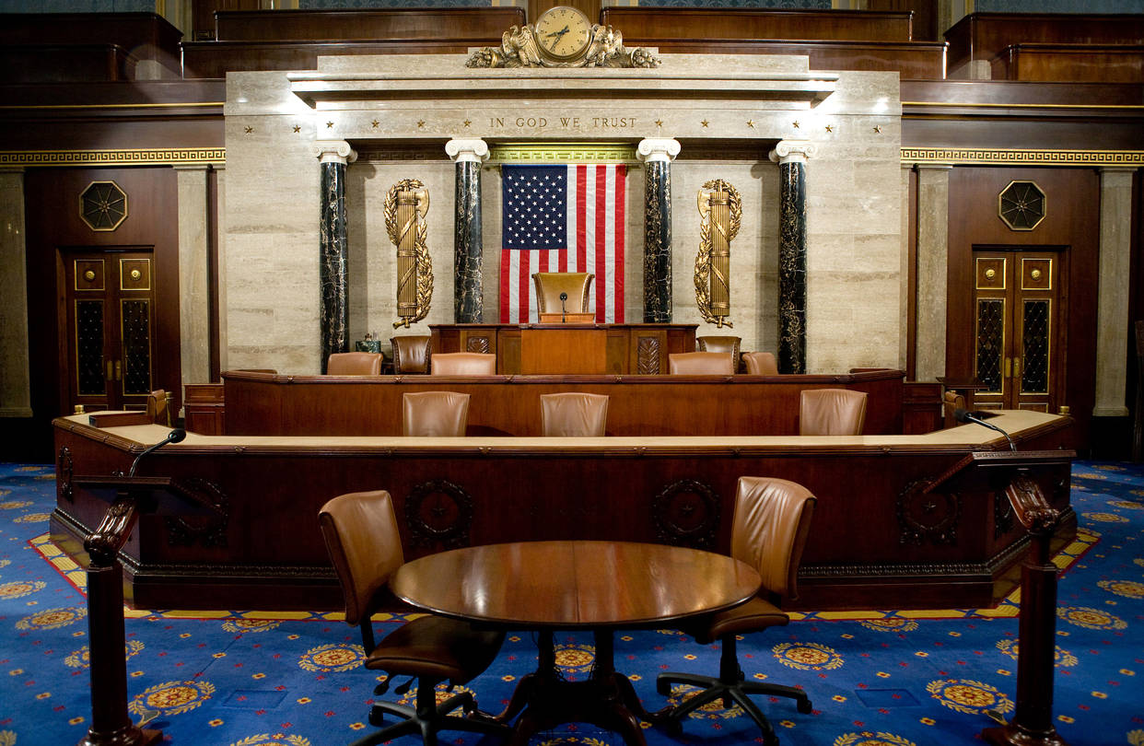

Slide 17
